Slide 1
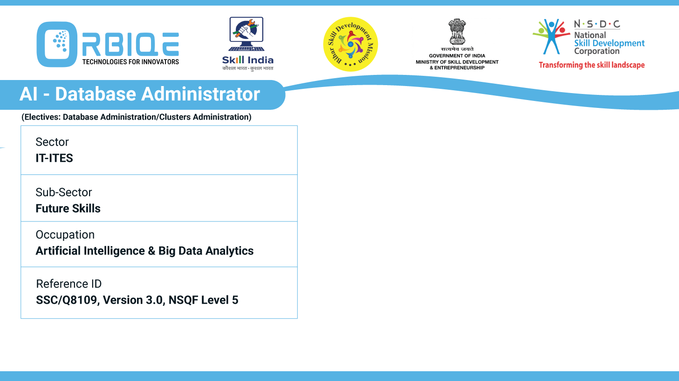
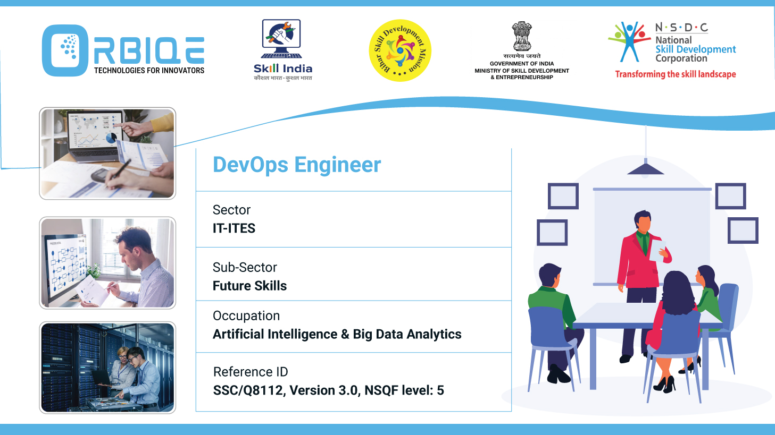
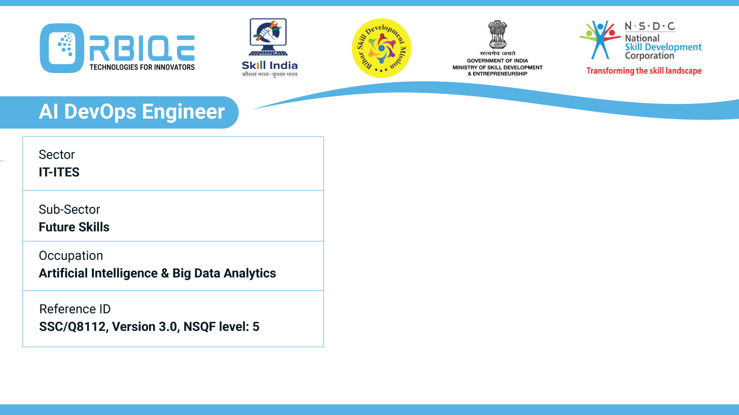
Name- Krishna Kant Dubey

Slide 2

Data Manipulation Mastery: Functions, Methods, and Sources

Slide 3
Agenda
Use different functions, methods, and sources to import, store, update, retrieve, and delete data from SQL and NoSQL databases or
data stores, mastering the art of data manipulation

Slide 4
SQL and NoSQL databases
SQL Databases (e.g., PostgreSQL, MySQL)
NoSQL Databases (e.g., MongoDB)

Slide 5

SQL Databases (e.g., PostgreSQL, MySQL)
Importing Data
Sql
Storing (INSERT)
Sql

Slide 6
SQL Databases (e.g., PostgreSQL, MySQL)
Updating
Sql
Retrieving
Sql

Slide 7
SQL Databases (e.g., PostgreSQL, MySQL)
Deleting
Sql

Slide 8
NoSQL Databases (e.g., MongoDB)
Importing Data
Base
Storing (Insert)
Js

Slide 9
Thank You

